Slide 1
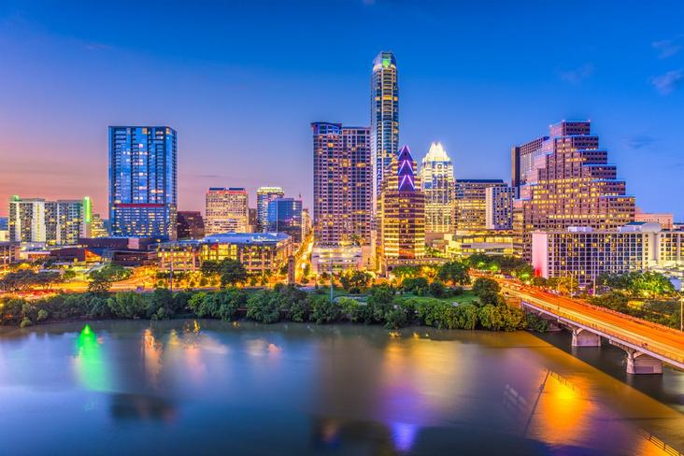
Hot
Science
Superhero Science
SUPER
Hot Science Cool Activities
www.HotScience.tv

Slide 2
Hot Science Guides
How to Use
Presentation: Share via projector screen or have available to students on individual devices
Reference speaker notes for answer key/ brainstorming suggestions
Worksheet Print-Out: Print a packet for each student to follow along with this presentation
NOTE: For this experiment test breaking the Life Saver first! If it is too humid, they may not spark. It is possible to bake them briefly to remove the excess moisture.

Slide 3
Learning
Objectives
  Explore triboluminescence by experimenting with Life Savers to produce visible sparks.
  Explain how breaking materials releases energy as light, similar to lightning.
  Analyze how factors like moisture and material composition affect triboluminescence.
1

Slide 4

Superhero
Science
1

Slide 5
Be a Superhero
Your Challenge
How could a wintergreen Life Saver replicate triboluminescence? Use pliers or your teeth to witness it before your eyes!
Materials
Wintergreen Life Savers (must use this specific flavor)
Pliers (if you prefer not to use your teeth)
Safety Goggles/Glasses
Paper towels
2

Slide 6

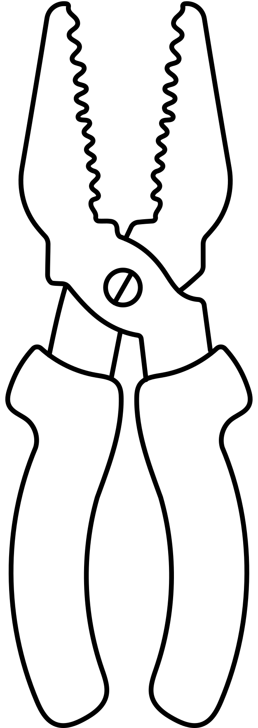
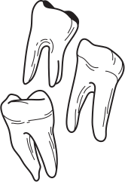
REMEMBER!
Method 1: Pliers
Pliers can pinch or cut if not used properly. Make sure to hold the pliers firmly and keep fingers away from the jaws.
Wear safety glasses to protect your eyes from any small candy fragments that might break off.
Method 2: Teeth
Do not do this method if you have braces or are worried about biting a hard candy.
Be aware of choking hazards! Be careful and stay mindful of the small pieces.
Wear safety glasses to protect your eyes from any small candy fragments that might break off.
Safety
Reminders
3

Slide 7
Lab Instructions
Method 1: Pliers
Separate into groups of 3-4
Place a Life Saver between the ends of the pliers so that you can see the hole.
Turn off the lights and let your eyes adjust to the darkness.
Squeeze the pliers together as quickly and forcibly as possible and observe the blue sparks.
Repeat this process 2 more times
Key
Steps
4
REMEMBER: Take your time and use safety precautions to avoid injury.
Notes:
If the sparks do not appear, try one of the following steps:
Make sure Life Savers are completely dry.
Place 2 between the ends of the plier together.

Slide 8
Lab Instructions
Method 2: Teeth
Separate into groups of 3-4
Each student receives 1 Life Saver
Turn off the lights and let your eyes adjust to the darkness.
Take turns drying the inside of your mouth with paper towels and crushing the Life Saver with your teeth.
Watch each groupmate to observe the sparks!
Key
Steps
5
REMEMBER: Take your time and use safety precautions to avoid injury.

Slide 9
Answer
Brainstorm
Did the Life Saver emit more than 1 flash of light? If so, why might that be?
What did you notice about the sparks? Were they bright? Dim? Yellow? Blue? Large? Small?
If you could change anything about this experiment, what would you change? Why?
6
Notes:
Ideally, students should witness more than one flash of light. This could happen because triboluminescence occurs as the sugar crystals in the Life Saver are fractured multiple times during the squeezing process. Each break in the crystal structure releases energy in the form of light, causing multiple flashes. This phenomenon occurs as long as the mechanical force is applied and more sugar crystals continue to break.
The sparks were likely small and dim, and they may have appeared blue or violet in color. This blue/violet light is characteristic of triboluminescence in sugar, as it results from the energy released when nitrogen molecules in the air are excited and emit light in this color spectrum. The flashes are typically small because only tiny portions of the sugar crystals break at a time.
Potential answers may include: a darker room to make the flashes easier to observe, they could try different flavors of Life Savers or hard candies to understand how the wintergreen, specifically, causes this reaction.

Slide 10
Learn
More
What causes this light?
Triboluminescence is the release of light that happens when an object's structure is broken or deformed (like Thor’s hammer hitting Captain America’s shield or your teeth hitting a Life Saver mint). This bending releases energy that makes nearby electrons excited. These newly excited electrons give off light as they go back to normal. If this process sounds familiar to you, that's because lightning is created by a similar process!
7
Notes:
Teacher note and animations

Slide 11
Learn
More
Why did we use wintergreen Life Savers?
Triboluminescence should occur in most hard candies, so why did we specify that a specific flavor of Life Saver be used? This is because the light released when crystals deform/break is mostly invisible (like the UV radiation from the sun). The wintergreen flavoring used in Life Savers happens to absorb invisible light and release it as visible light, allowing us to see it. Other hard candies without this flavoring will still emit light when broken, but it would be much harder to see with the naked eye.
8

Slide 12
Learn
More
Why does moisture affect the process?
Sucrose (the primary ingredient in Life Savers) dissolves in water. Any exposure to water will cause small portions of the candy to dissolve, changing the structure of the Life Saver, causing it to become soft. Because the structure is no longer perfectly crystalline it will no longer break in the same way.
9

Slide 13
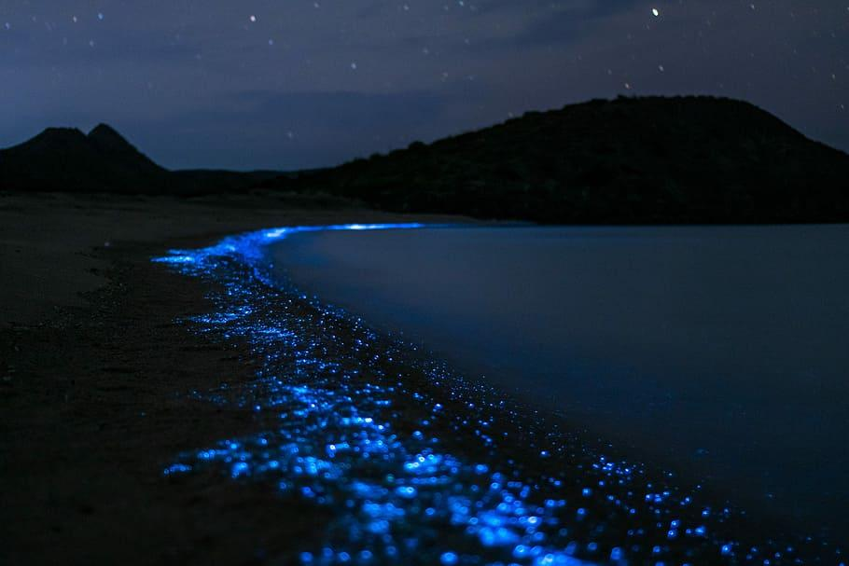
Learn
More
What are some other types of luminescence that can be found?
Electro: lightbulbs (fluorescent lighting!)
Radio: Aurora Borealis (“northern lights”)
Photo: X-Ray
Bio: plankton beaches
10

