Slide 1
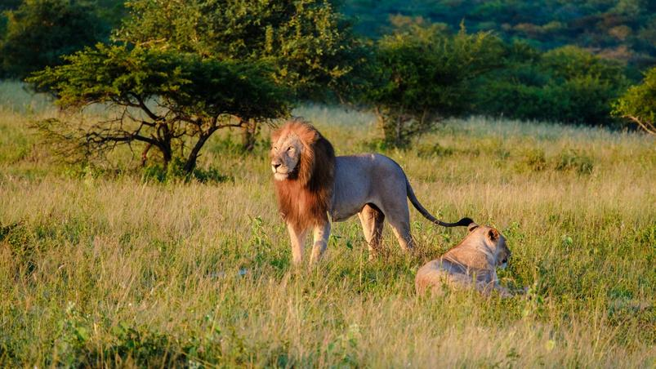
Hot
Science
Hot
Science
Evolution of Beauty
Hot Science Cool Activities
www.HotScience.tv
www.HotScience.tv

Slide 2
Hot Science Guides
How to Use
Presentation: Share via projector screen
Reference speaker notes for answer key/ brainstorming suggestions
Worksheet Print-Out: Print a packet for each student to follow along with this presentation

Slide 3
Learning
Objectives
Organisms that we describe as beautiful tend to stand out from their environment.
Beauty allows organisms to stand out and attract potential mates.
Predators tend to target organisms that stand out from their environment.
Adaptive traits, like beauty, can be advantageous in regards to sexual selection (finding a mate) while being harmful for natural selection (more likely to be eaten).
1

Slide 4
Your Challenge
Animals are more likely to mate if they have characteristics that allow them to stand out.
Unfortunately, standing out means predators can find the animal more easily as well! Explore an example where beauty kills by observing M&M’s in their natural habitat.
A Taste for the Beautiful
Materials
Orange or red piece of construction paper.
A large collection of M&Ms (about 15 – 20 M&M’s per color).
Timer
Pencil
2

Slide 5
Feeding
Frenzy
With a partner, decide who is going to be in each role.
The Predator: You hunt like a bird of prey precisely picking up M&M’s one at a time with your fingers.
The Biologist: You are a biologist studying the M&M’s. Your job is to mark the initial and final population of M&M’s on the table and to observe how the predator hunts.
3

Slide 6
Setting up: Pour about 20 M&M’s on the construction paper
Record the number of M&M’s there are of each color in your table under the “Before Predation” row.
Biologist: set a timer for 20 seconds for the feeding frenzy.
Predator: During the 20-second timer, use your fingers to grab M&M’s and and set them in a pile in front of you. Remember, you strike the first critter you see with speed and precision.
When the timer goes off, STOP!
Biologist: Record the number of remaining M&M’s of each color in your table under the “After Predation” row.
Feeding
Frenzy
4

Slide 7
Questions
to Ponder
Context questions:
Which colors of M&M’s were most likely to get eaten by the predator? Why?
Which colors were least likely to be eaten? Why?
Did any colors go extinct (completely disappear from an environment)?
5
Notes:
The colors of M&M’s that were most likely to get eaten by the predator are those that contrast strongly with the construction paper background. This is because they stand out against the background, making them easier for the predator to spot.
The colors of M&M’s that were least likely to be eaten are those that blend in with the construction paper background. This camouflage effect makes them harder to detect.
It is possible that some colors of M&M’s could go extinct if they are extremely visible and are consumed entirely during the feeding frenzy.

Slide 8
Questions
to Ponder
Reflection questions:
How would you expect the population of M&Ms to change over time? (Hint: Remember the process of natural selection.)
How might your data change if this experiment was performed with brown construction paper instead? How about green?
6
Notes:
Over time, the population of M&Ms would likely show an increase in the colors that are better camouflaged to the background and a decrease in the more visible colors.
Brown Construction Paper: M&M’s that are brown or darker colors would be less visible and therefore less likely to be eaten, while bright colors like yellow or red would be more visible and likely to be consumed more frequently. Green Construction Paper: M&M’s that are green or similar colors would blend in and be less likely to be eaten, while bright colors like red or yellow would stand out and be consumed more frequently.

Slide 9
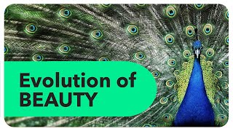
Evolution Of Beauty
7

Slide 10
What does it mean for an animal to be beautiful?
Based on both the video and the experiment, what are the advantages and disadvantages of standing out in nature?
Suppose you find that the percentage of bright blue and yellow M&Ms increased overtime despite their higher risk of being consumed. What might explain this phenomena?
What other reasons might an organism have to stand out in its environment?
Group
Discussion
8
Notes:
In the context of natural selection and predation, being "beautiful" typically refers to having striking or bright colors that can attract mates or signal certain traits. However, it can also mean having patterns or colors that are not advantageous for avoiding predators.
Advantages: Standing out can attract potential mates, signal to others of the same species, and sometimes serve as a warning to predators if the animal is toxic or dangerous. Disadvantages: Being highly visible can increase the likelihood of being spotted and eaten by predators. It can also make the animal more vulnerable to environmental changes or other threats.
If bright blue and yellow M&Ms increase over time despite their higher risk of being consumed, it could indicate a couple of things:
Selection Pressure: The experiment might have started with a higher proportion of bright colors or there could be a high initial concentration of these colors. If these colors were not completely eaten, they might have been overrepresented in the initial setup.
Predator Behavior: The predator might be biased or inconsistent in its eating habits, allowing some bright-colored M&Ms to remain and reproduce (if applicable).
Experimental Error: There might be errors or biases in the data recording or in the procedure that could skew results
These factors contribute to an organism’s evolutionary strategies for survival and reproduction:
Mimicry: To mimic other dangerous or toxic organisms as a defense mechanism (e.g., harmless animals mimicking the coloration of poisonous ones).
Social Signaling: To communicate with others in the same species, such as signaling dominance or attracting mates (e.g., peacocks displaying their feathers).
Warning Coloration: To indicate that it is toxic or unpalatable to potential predators.
Habitat Specificity: To blend into specific environments or to be visible to certain types of mutualistic species (e.g., pollinators).

